Slide 1

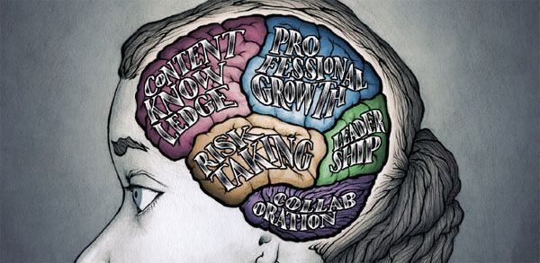


Teachers & teacher content knowledge in SA
Finding a way forward
www.nicspaull.com/presentations
CPLO Roundtable on Teachers | 13 October 2014

Slide 2
Thank you
Comments & Questions?
This presentation and papers available online at: www.nicspaull.com/research

Slide 3
Teacher union membership in SA
(as at 31 December 2012)
Breakdown as at 31 December 2012 (Audited stats for December 2013 will be availabkle mid-year)
These Stats include educators and a small numebr of support staff
Union | EC | GP | FS | KZN | LP | MP | NC | NW | WP | TOTAL
SADTU | 45968 | 29307 | 13853 | 57086 | 43706 | 25750 | 5826 | 18572 | 12944 | 253012
NAPTOSA | 12508 | 14805 | 4171 | 7346 | 687 | 2701 | 934 | 3335 | 9651 | 56138
SAOU | 2957 | 8090 | 4925 | 1244 | 1174 | 2452 | 1581 | 2242 | 4197 | 28862
PEU | 380 | 2807 | 71 | 193 | 7824 | 1728 | 128 | 1210 | 0 | 14341
NATU | 380 | 580 | 416 | 25424 | 55 | 1334 | 0 | 284 | 0 | 28473
TOTALS | 16225 | 26282 | 9583 | 34207 | 9740 | 8215 | 2643 | 7071 | 13848 | 127814
Thanks to Mike Myburgh (NAPTOSA) for supplying data
Notes:
There are two sources for the data: the main one is the PSCBC – Public Service Co-ordinating Bargaining Council (this is the forum where all of the public sector unions, including educator unions, bargain with the State on matters of mutual interest) And secondly the ELRC – Education Labour Relations Council (this is specifically for educator unions and the DBE to negotiate on matters not part of the PSCBC). Both conduct audits on an annual basis. These are not without errors! I tried to correct one or two of the significant figures and as indicated added in the Ind Sch and SGB members for NAPTOSA. SAOU may have about 2000 such members in addition to their State employed members (not certain of this though).

Slide 4
Accountability: teacher absenteeism
(SACMEQ III – 2007 – 996 teachers)
Notes:
Absenteeism here is average between both maths and reading teachers

Slide 5
Teacher absenteeism
SACMEQ III (2007)
What is the distribution of teacher absenteeism across school SES quintiles?

Slide 6


By Gr 3 all children should be able to read, Gr 4 children should be transitioning from “learning to read” to “reading to learn”
Red sections here show the
proportion of children that are
completely illiterate in Grade 4
, i.e. they cannot read in any
language
Notes:
If we consider the performance of the learners per test language, the following observations are made:
Overall 29% of learners in SA don’t meet the low benchmark
However, in Afrikaans and English, there are only 12 and 10% who do not meet the low benchmark
Of serious concern is that more than half the learners tested in Sepedi and Tshivenda do not reach the low benchmark putting them at risk educationally.
More than 15% of learners in Afrikaans and English reach the advanced level in contrast to less than 1% in African languages.
http://web.up.ac.za/sitefiles/File/publications/2013/PIRLS_2011_Report_12_Dec.PDF

Slide 7
Figure 2: Average Grade Eight mathematics test scores for middle-income countries participating in TIMSS 2011 (+95% confidence intervals around the mean)
TIMSS Maths (2011)

Slide 8
How do SA’s wealthiest 20% of school perform?
RE Max DuPreez’s comments yesterday that our Model-C schools are “good”, even by international stds
Important to remember size of SA schooling system (25,000 schools, the top 2% =500 schools!)
Top 1% probably, not top 15% →
Graph via Stephen Taylor (TIMSS 2003)

Slide 9
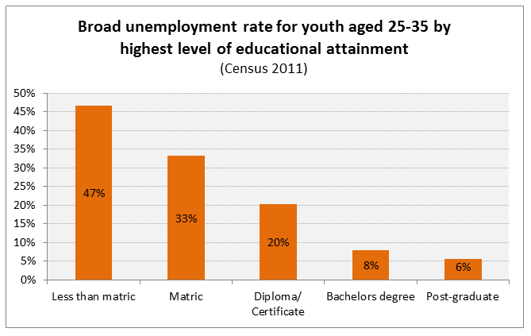
Notes:
http://africacheck.org/2014/01/10/the-economic-value-of-matric-and-the-potential-of-further-education-colleges/

Slide 10
Dropout between Gr8 and Gr12
Of 100 Gr8 quintile 1 students in 2009, 36 passed matric and 10 qualified for university
Of 100 Gr8 quintile 5 students in 2009, 68 passed matric and 39 qualified for university
“Contrary to what some would like the nation and the public to believe that our results hide inequalities, the facts and evidence show that the two top provinces (Free State and North West) are rural and poor.” (Motshekga, 2014)
Notes:
http://nicspaull.com/2014/01/12/education-in-sa-still-separate-and-unequal-extended-version-of-citypress-article/

Slide 11
Qualifications by age (birth cohort), 2011 (Van der Berg, 2013)

Slide 12
Links between education & the labour-market
Intervening in the labour-market (BBBEE) is too late
  Need to do this but MORE focus on (pre) school.
Social grants important to reduce abject poverty but cannot change inequality much
Wages account for 80% of total inequality
Unless you can increase the wages of black labour-market entrants cannot change structure of SA income distribution
(4) not possible without improving quality of education.

Slide 13
SOLUTION?
Accountability AND
Capacity

Slide 14
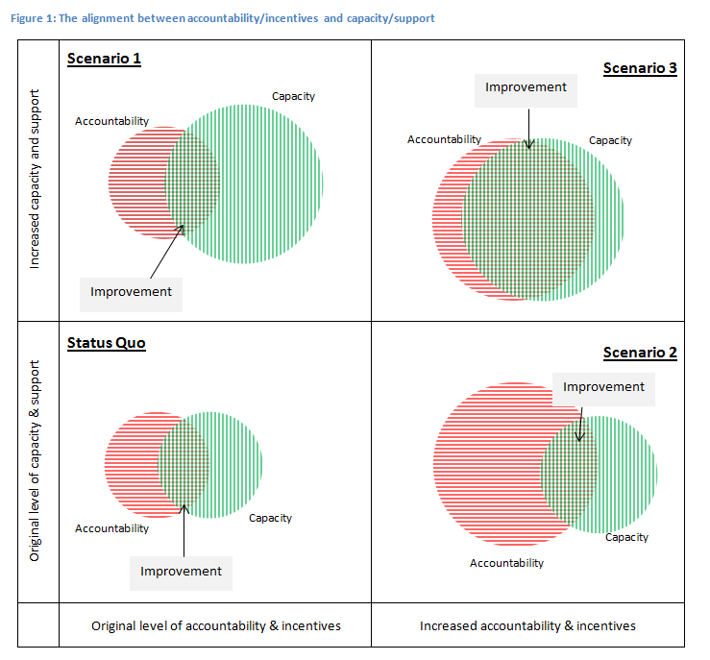
Notes:
From: http://ijr.org.za/publications/pdfs/TA%202013%20text%20and%20cover%20web.pdf

Slide 19
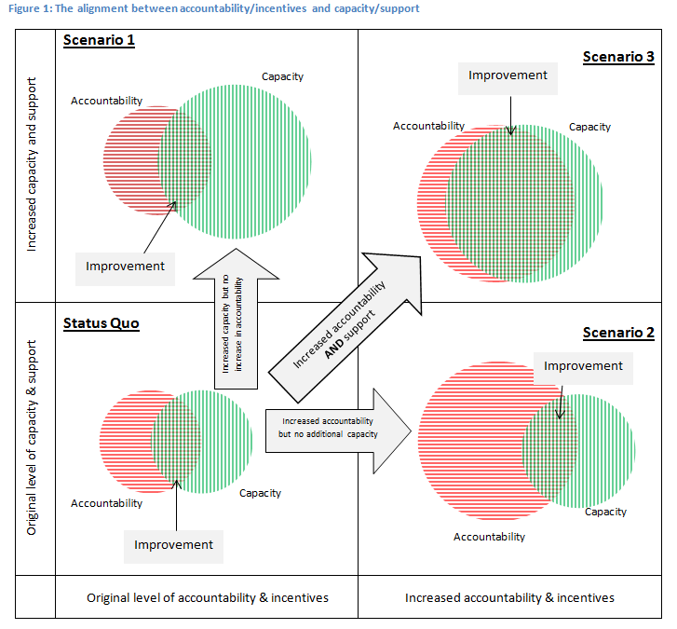

Slide 20
“Only when schools have both the incentive to respond to an accountability system as well as the capacity to do so will there be an improvement in student outcomes.” (p22)
Notes:
http://ijr.org.za/publications/pdfs/TA%202013%20text%20and%20cover%20web.pdf

Slide 21
There are signs of hope…
The DBE has begun to focus on the basics
  CAPS curriculum
  Workbooks (numeracy and literacy)
  ANAs (not without problems)
Some improvement in Gr9 student outcomes between TIMSS 2003 and TIMSS 2011
  1.5 Grade levels (but post-improvement still exceedingly low)

Slide 22
Way forward?
Acknowledge the extent of the problem
  Low quality education is one of the three largest crises facing our country (along with HIV/AIDS and unemployment). Need the political will and public support for widespread reform.
Focus on the basics
  Every child MUST master the basics of foundational numeracy and literacy these are the building blocks of further education – weak foundations = recipe for disaster. Read by 10 goal!
  Teachers need to be in school teaching (re-introduce inspectorate?)
  Every teacher needs a minimum competency (basic) in the subjects they teach
  Every child (teacher) needs access to adequate learning (teaching) materials
  Use every school day and every school period – maximise instructional time
  Have to make sure we don’t make the same mistakes with Grade R as we have with the rest of schooling
Increase information, accountability & transparency
  At ALL levels – DBE, district, school, classroom, learner
  Strengthen ANA. Get psychometrics right (so comparable across years), externally evaluate @ 1 grade
  Set realistic goals for improvement and hold people accountable
Focus on teachers
  Have to find a way of raising the quality of both (1) new, but especially (2) existing teachers
  Q&A - Prof Muller (UCT): What do you think is the most under-researched area in South African education?
    “We have no idea what it will take to make knowledgeable teachers out of clueless ones, at least not while they are actually on-the-job.”

Slide 23
5 “Take-Home” points
Many things we have not discussed – Grade-R/ECD, teacher unions and politics, civil service capacity constraints, LOLT, teacher training (in- and pre-), RCTs, resources, etc.
South Africa performs extremely poorly on local and international assessments of educational achievement.
In SA we have two public schooling systems not one.
Teacher content knowledge in South Africa is extremely low
In large parts of the schooling system there is very little learning taking place.
Strategies for improvement need to focus on 1) accountability, 2) capacity, 3) alignment.
Low quality education
Low social mobility
Hereditary poverty

Slide 24
Further issues we can discuss
Solution: Identifying binding constraints
Grade R in SA – not more of the same
Resources
New and existing RESEP projects
What proportion of SA kids make it to uni?
What can businesses do to help?
  Warm-glow effect or turning the ship?

Slide 25
References & further reading
For work on poverty and inequality – SALDRU/RESEP websites & working papers good start.
Fiske, E., & Ladd, H. (2004). Elusive Equity: Education Reform in Post-apartheid South Africa. Washington: Brookings Institution Press / HSRC Press.
Fleisch, B. (2008). Primary Education in Crisis: Why South African schoolchildren underachieve in reading and mathematics. Cape Town. : Juta & Co.
Donalson, A. (1992). Content, Quality and Flexibility: The Economics of Education System Change. Spotlight 5/92. Johannesburg: South African Institute of Race Relations.
Taylor, S., & Yu, D. (2009). The Importance of Socioeconomic Status in Determining Educational Achievement in South Africa. Stellenbosch Economic Working Papers.
Van der Berg, S., Burger, C., Burger, R., de Vos, M., du Rand, G., Gustafsson, M., Shepherd, D., Spaull, N., Taylor, S., van Broekhuizen, H., and von Fintel, D. (2011). Low quality education as a poverty trap. Stellenbosch: University of Stellenbosch, Department of Economics. Research report for the PSPPD project for Presidency.
Spaull, N. 2013. Poverty & Privilege: Primary School Inequality in South Africa. International Journal of Educational Development. 33 (2013) pp. 436-447 (WP here)
Spaull, N. 2013. South Africa’s Education Crisis: The Quality of Education in South Africa 1995-2011. Centre for Development and Enterprise.

Slide 26
Current concerns of DBE
(according to me)
Teacher content knowledge
- Extremely low
- Politically sensitive given strength of teacher unions
-Testing & training?!
Grade R & ECD
- Funding: Current exp on Grade R pupil (R3K) 1/3 of ordinary school child (R10K)
-Training/qualifications and $ of ECD teachers?
Teacher Salaries
– Make up 80% of Educ Exp ating infrastructure backlogs
- Legal implications of MN&S (provinces held to acc)
FP Numeracy & literacy and ANAS
- Ensuring they are comparable across years
- Using them to raise numeracy & literacy outcomes
-
Min Norms/Stds
- Eradicating infrastructure backlogs & providing basics (and then non-basics)
- Legal implications of MN&S (provinces held to acc)
Elections & Relations with teacher unions
- Teacher unions (esp SADTU) wield considerable power)
-Appointments (DBE/district/principal/teacher) politicised, competence not primary concern
Post-provisioning
- Ghost teachers
-Over/under supply in certain schools (esp ECA)
-limiting the salary bill

Slide 27
Binding constraints approach

Slide 28
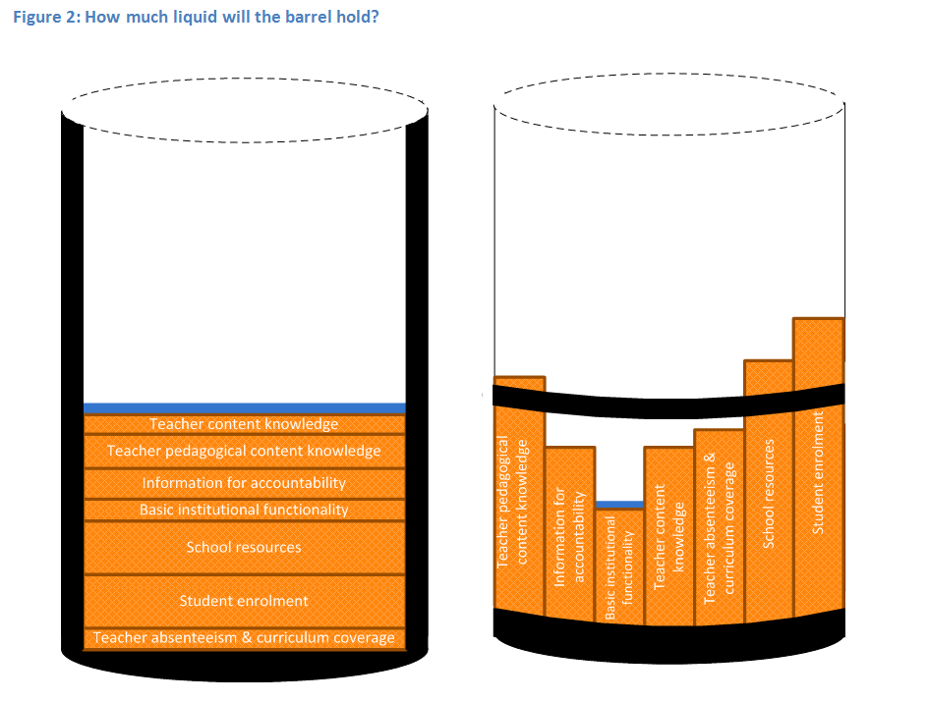

Slide 31
“The left hand barrel has horizontal wooden slabs, while the right hand side barrel has vertical slabs. The volume in the first barrel depends on the sum of the width of all slabs. Increasing the width of any slab will increase the volume of the barrel. So a strategy on improving anything you can, when you can, while you can, would be effective. The volume in the second barrel is determined by the length of the shortest slab. Two implications of the second barrel are that the impact of a change in a slab on the volume of the barrel depends on whether it is the binding constraint or not. If not, the impact is zero. If it is the binding constraint, the impact will depend on the distance between the shortest slab and the next shortest slab” (Hausmann, Klinger, & Wagner, 2008, p. 17).
Notes:
Hausmann, R., Klinger, G., & Wagner, R. (2008). Doing Growth Diagnostics in Practice: A 'Mindbook'. CID Workinf Paper No. 177. Center for International Development at Harvard University.

Slide 32
Grade R/ECD issues needing to be fleshed out?
Qualitatively/practically, when is enrolment considered “Grade R” and when just child-minding?
Where should Grade R teachers be trained?
  Universities? More of the same?
  FET colleges? Quality problems? Status?
Practically, how does one monitor quality of ECD? What instruments? What surveys?
What should Grade R teachers be paid?
  Teacher salaries (and class sizes) obviously major cost-drivers

Slide 34
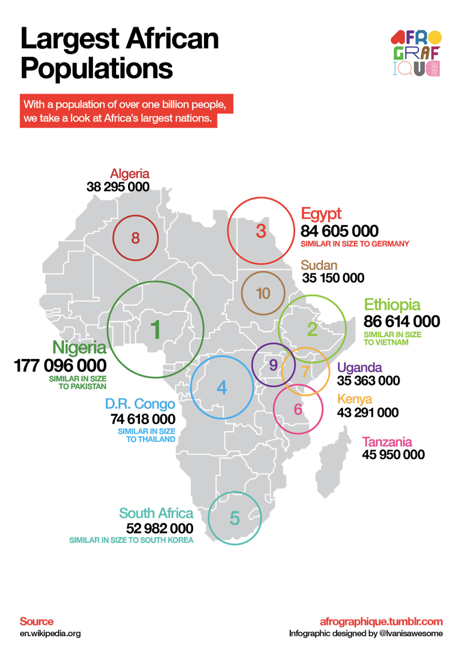
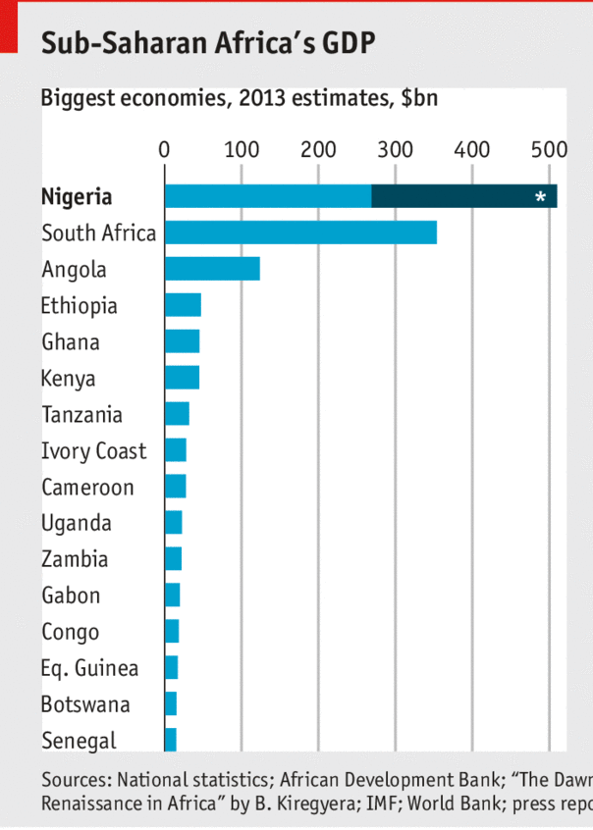
Size of South African economy/population

Slide 35
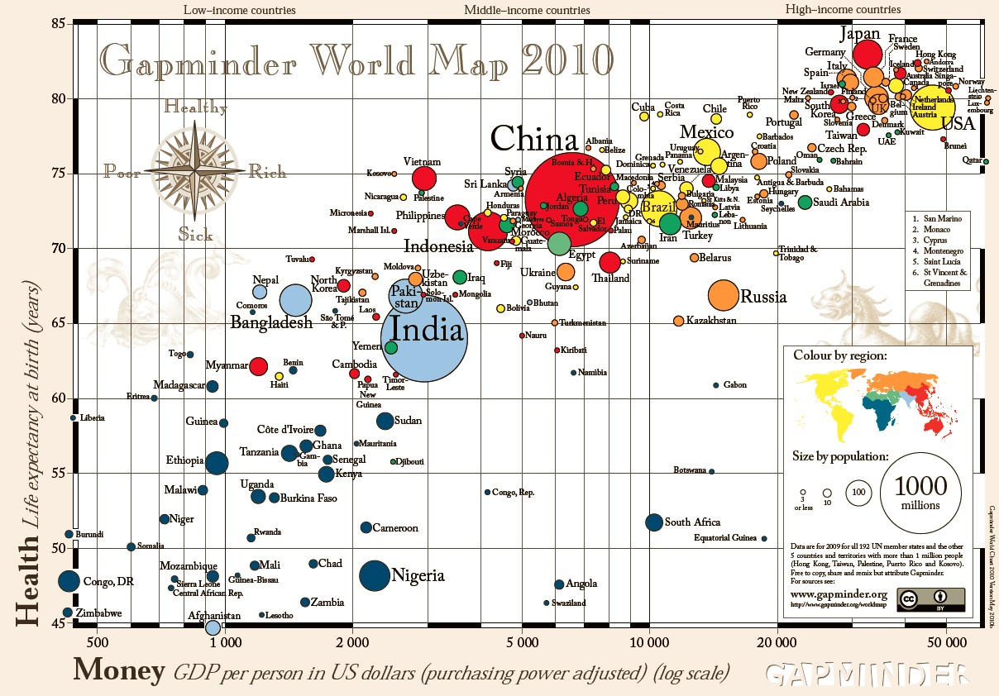

Slide 36
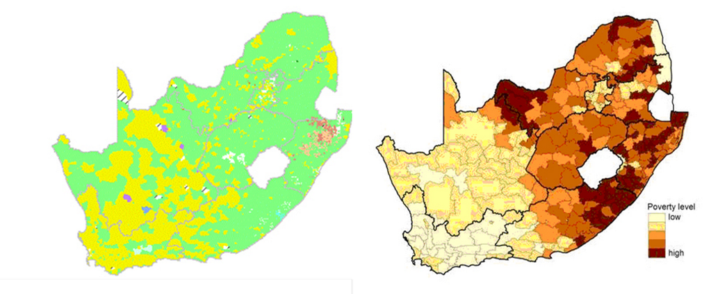
Geographic distribution of poverty

Slide 37
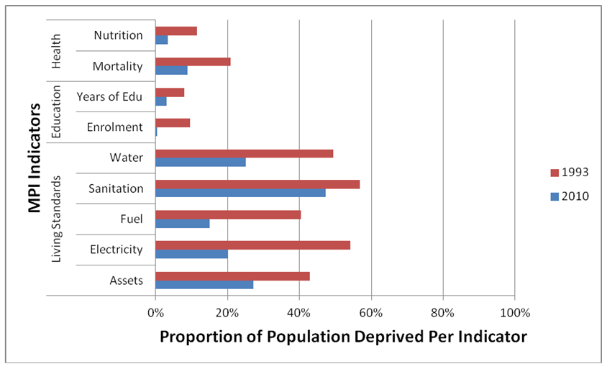
Sources of deprivation?

Slide 38


Benefits of education
Ed
S
H
Ec
Improved human rights
Empowerment of women
Reduced societal violence
Promotion of a national (as opposed to regional or ethnic) identity
Increased social cohesion
Lower fertility
Improved child health
Preventative health care
Demographic transition
Improvements in productivity
Economic growth
Reduction of inter-generational cycles of poverty
Reductions in inequality
$
Health
Economy
Society
Specific references: lower fertility (Glewwe, 2002), improved child health (Currie, 2009), reduced societal violence (Salmi, 2006), promotion of a national - as opposed to a regional or ethnic - identity (Glewwe, 2002), improved human rights (Salmi, 2006), increased social cohesion (Heyneman, 2003), Economic growth – see any decent Macro textbook, specifically for cognitive skills see (Hanushek & Woessman 2008)

Slide 39
Accountability stages...
SA is a few decades behind many OECD countries. Predictable outcomes as we move from stage to stage. Loveless (2005: 7) explains the historical sequence of accountability movements for students – similar movements for teachers?
  Stage 1 – Setting standards
  (defining what students should learn),
      CAPS
  Stage 2 - Measuring achievement
  (testing to see what students have learned),
      ANA
  Stage 3 - Holding educators & students accountable
  (making results count).
      Western Cape performance agreements?
Stages in accountability movements:
3) Holding accountable
2) Measuring achievement
1) Setting standards
TRAINING
“For every increment of performance I demand from you, I have an equal responsibility to provide you with the capacity to meet that expectation. Likewise, for every investment you make in my skill and knowledge, I have a reciprocal responsibility to demonstrate some new increment in performance” (Elmore, 2004b, p. 93).

Slide 40


What are the root causes of low and unequal achievement?
Matric pass rate
Subject choice
No. endorsements
Throughput
Media sees only this→
Quality?
MATRIC
Pre-MATRIC
50% dropout
Low curric coverage
Weak culture of T&L
Low accountability
Vested interests
Low time-on-task
No early cognitive stimulation
Low quality teachers
HUGE learning deficits…

Slide 41
Basic overview of matric 2013
The good…
Matric pass rate increased to 78%
Bachelor pass rate increased to 31%
More students passing mathematics
The bad…
Some questioning quality of matric pass
Public starting to ask questions about why uni’s are using NBTs
Concerns over “culling” and whether this lead to increases in NWP and FST
The ugly…
Grade 8→12 dropout is 2x as high (50%) in Q1 rel to Q5 (25%)
Because of differences in average quality of education, a white child is 7 times more likely than a black child to obtain a Maths D+ and 38 times as likely to get an A- aggregate (using earlier matric data)

Slide 42
Focus on mathematics – things are improving
Number of students taking mathematics (as opposed to maths-lit) has declined since 2008, but proportion passing has risen
  Not necessarily a bad thing since many of those students shouldn’t have been taking mathematics in the first place
Source: Taylor (2014)

Slide 43
What proportion of matrics take and pass mathematics?
Important statistic is the number passing which was declining from 2008 → 2011 but has increased between 2011 → 2013
Source: Taylor (2014)

Slide 44
Matric mathematics statistics (Taylor 2014)
 | Numbers wrote maths | Number passed maths | Maths pass rate | Proportion taking maths | Proportion passing maths
2008 | 298821 | 136503 | 45.70% | 56.10% | 25.60%
2009 | 290407 | 133505 | 46.00% | 52.60% | 24.20%
2010 | 263034 | 124749 | 47.40% | 48.80% | 23.20%
2011 | 224635 | 104033 | 46.30% | 45.30% | 21.00%
2012 | 225874 | 121970 | 54.00% | 44.19% | 23.86%
2013 | 241509 | 142666 | 59.10% | 42.96% | 25.38%
Source: Taylor (2014)
NOTE: All of the above is under the proviso that that quality of the mathematics exam has remained constant over the period. If not then we can’t say much.

Slide 45
Are things improving?
What should we be using to measure changes over time?
  DEFINITELY *NOT* ANAs
    Not psychometrically calibrated to be comparable year-on-year
    No anchor items
    No Item Response Theory
    Not externally evaluated and independently marked
    No, no, no.
    Need a broader discussion of the potential perils of ANAs. Under-appreciated at the moment. ANA Fridays?!
  Matric – sort of yes
    Considerable institutional memory (decades of expertise and precedent)
    Excludes half the cohort so not a good reflection of total education system
    Can be tricky to tease out *real* trends. Things like subject combinations, culling, pass thresholds and clumping around the threshold etc.
  Cross-national assessments – yes.
    Best way of determining if there are changes over long periods of tims
      TIMSS, PIRLS/prePIRLS/SACMEQ/ (perhaps PISA in SA soon)
Education and schooling (the main vehicle we use to “do/get it”) cannot be reduced to test scores or particular subjects (numeracy and literacy). However, that does *NOT* mean that there is no place for testing. Many educational outcomes are measurable and providing feedback to everyone (DBE, principals, parents, students) is an important form of accountability.

Slide 46
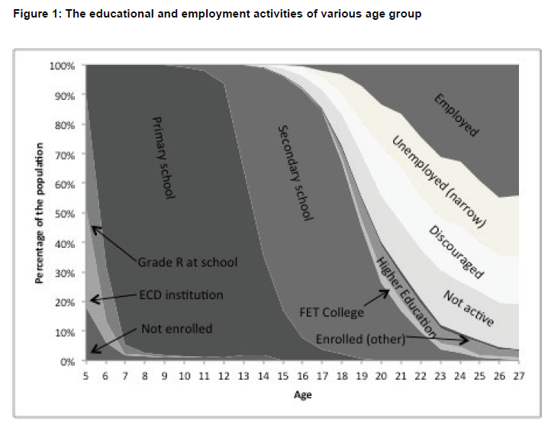
Higher education in perspective
When speaking about higher education it’s important to remember that this is only a very small proportion of the population
Source: DBE (2013) Internal Efficiency of the schooling System

Slide 47
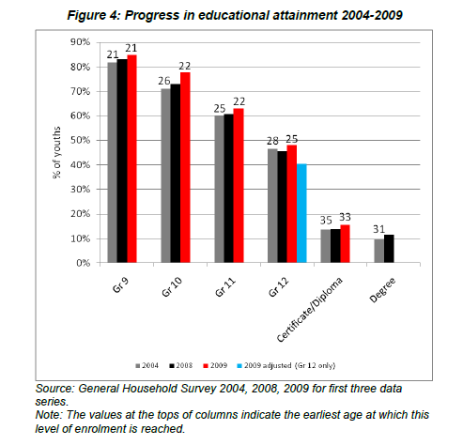
Gustafsson, 2011 – When & how WP
“What do the magnitudes from Figure 4 mean in terms of the holding of qualifications? In particular, what widely recognised qualifications do the 60% of youths who do not obtain a Matric hold? …Only around 1% of youths hold no Matric but do hold some other non-school certificate or diploma issued by, for instance, an FET college”
(Gustafsson, 2011: p.11)
10%
Notes:
http://www.ekon.sun.ac.za/wpapers/2011/wp092011

Slide 48
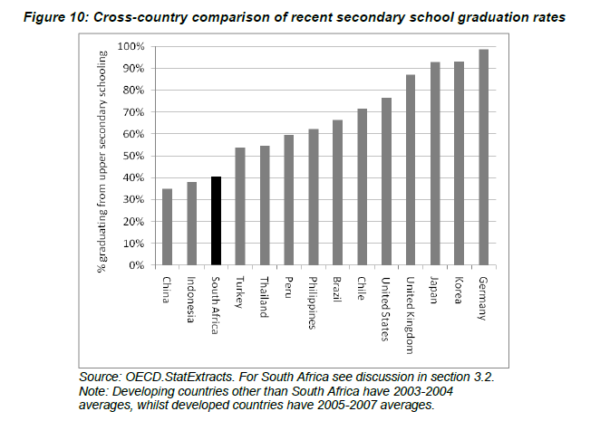
How does SA fair internationally?
Gustafsson (2011) “The when and how of leaving school”
Notes:
http://www.ekon.sun.ac.za/wpapers/2011/wp092011

Slide 49
TIMSS 1995 → 2011
Figure 1: South African mathematics and science performance in the Trends in International Mathematics and Science Study (TIMSS 1995-2011) with 95% confidence intervals around the mean

Slide 50
Accountability: teacher absenteeism
  Teacher absenteeism is regularly found to be an issue in many studies
    2007: SACMEQ III conducted – 20 days average in 2007
    2008: Khulisa Consortium audit – HSRC (2010) estimates that 20-24 days of regular instructional time were lost due to leave in 2008
    2010: “An estimated 20 teaching days per teacher were lost during the 2010 teachers’ strike” (DBE, 2011: 18)
    Importantly this does not include time lost where teachers were at school but not teaching scheduled lessons
      A recent study observing 58 schools in the North West concluded that “Teachers did not teach 60% of the lessos they were scheduled to teach in North West” (Carnoy & Chisholm et al, 2012)
Notes:
Also see Chisholm (2005) and Shisana et al (2005) quoted in HSRC (2010)

Slide 51
2 education systems
Dysfunctional Schools (75% of schools) | Functional Schools (25% of schools)
Weak accountability | Strong accountability
Incompetent school management | Good school management
Lack of culture of learning, discipline and order | Culture of learning, discipline and order
Inadequate LTSM | Adequate LTSM
Weak teacher content knowledge | Adequate teacher content knowledge
High teacher absenteeism (1 month/yr) | Low teacher absenteeism (2 week/yr)
Slow curriculum coverage, little homework or testing | Covers the curriculum, weekly homework, frequent testing
High repetition & dropout (Gr10-12) | Low repetition & dropout (Gr10-12)
Extremely weak learning: most students fail standardised tests | Adequate learner performance (primary and matric)

Slide 52
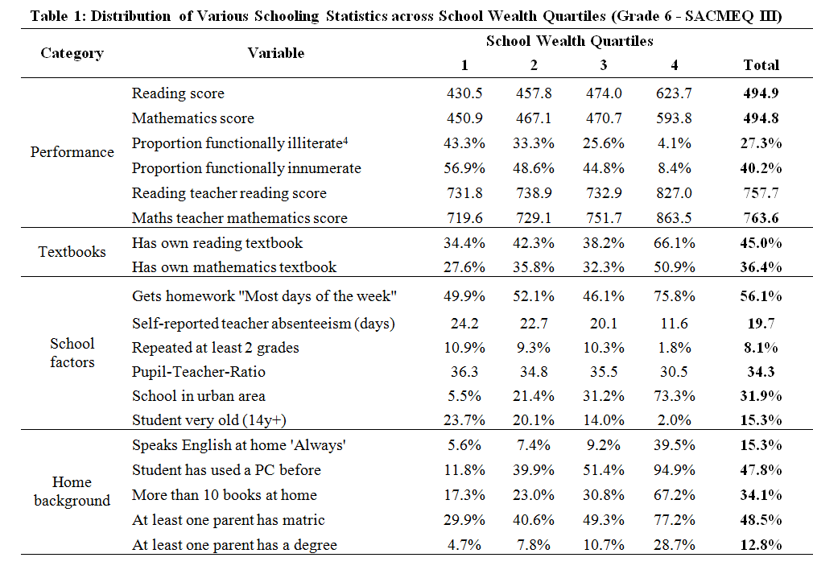
Implications for reporting and modeling??

